Slide 1


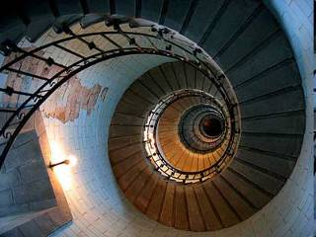


The Elements of Composition

Slide 2

Remember this…
“anything you’ve taken a picture of, you put a frame around it and you’ve narrowed the viewer’s eyesight and said look at this, this is special ”…

Slide 3

The term composition means 'putting together‘.
Any work of art is arranged or “put together” using conscious thought in order to communicate an idea.

Slide 4

For effective visual communication, your image must
have both strength and clarity.
The viewer can become bored with your image if either is lacking.

Slide 5

The term strength pertains to the ability of your
image to attract the viewer's attention.
If you're not able to gain
attention immediately, your image will be ignored.

Slide 6
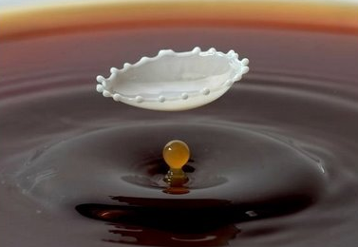
Clarity refers to the ability of your image to maintain
the viewer's interest.
Notes:
This is accomplished by allowing the viewer to explore the parts and subtleties of the image. You must provide a mechanism for the viewer's eye to examine all parts of the scene and return to the main area of focus.
The viewer will abandon the image before examining the various parts and subtleties if the image lacks strength.

Slide 7

There are several composition principles that can be used to enhance strength, and clarity in your images.

Slide 8

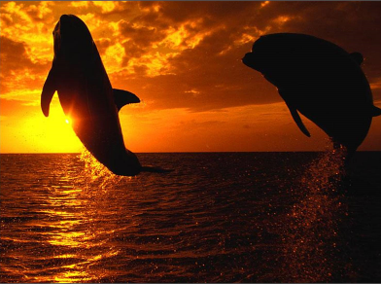


There is, however, no “right way” to take a photograph.
Three photographers recording the same scene may create equally appealing photos with entirely different compositions.

Slide 9
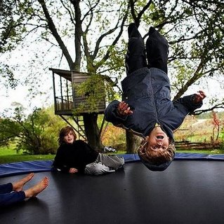
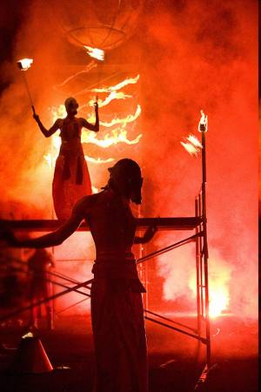
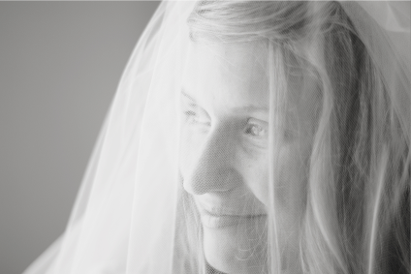
Even though the following principles have emerged for good composition-and they seem rather clear - they should always be considered guidelines, not rules.
Composition is an art, not a science.

Slide 10



1. Compose around a Visual (Single) Center of Interest.
Before shooting your photo, ask yourself what major element in the shot communicates your basic idea.
Notes:
Identify a primary point of interest before taking the picture. When you’ve determined which area is the most important to you, you can compose to emphasize it. (Studying advertising photographs is a good way to get acquainted with emphasis in composition.)
Before shooting your photo, ask yourself what major element in the shot communicates your basic idea. Starting with the most obvious, it may be the person speaking. Or it may be something quite subtle and symbolic.

Slide 11
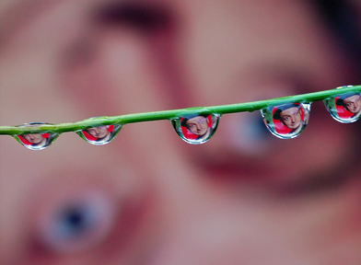


1. Compose around a Visual Center of Interest.
You can isolate the subject by throwing the background out of focus.
Notes:
Our eyes are attracted to areas with sharp focus.
The viewer's eye generally will not remain very long in an area that is out of focus.

Slide 12



Having too many things to look at causes fatigue in the viewer's eye.
Notes:
However, when everything is in sharp focus, the image becomes cluttered and won't hold the viewer's attention.

Slide 13
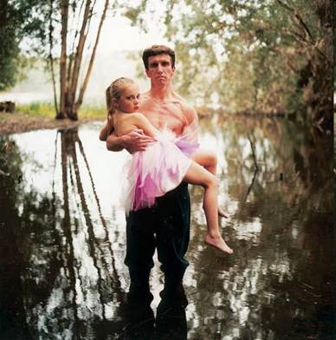
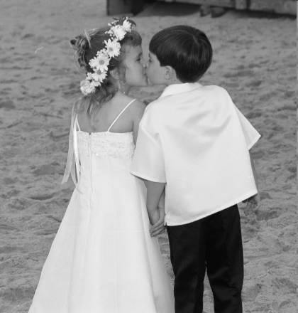

Think about your subject and use the frame to focus attention on the subject while eliminating unnecessary clutter.
Notes:
The key is simplicity
Be sure that only the things you want the viewer to see appear in the picture. If there are numerous objects cluttering up the background, your message will be lost.
If you can’t find an angle or framing to isolate your subject, consider using depth of field control to keep the background out of focus.
Whatever it is, the secondary elements within the scene should support and not pull attention away from it.
Multiple centers of interest may work in three-ring circuses where viewers are able to fully shift their interest from one event to another. But competing centers of interest within a single visual frame weaken, divide and confuse meaning.

Slide 14

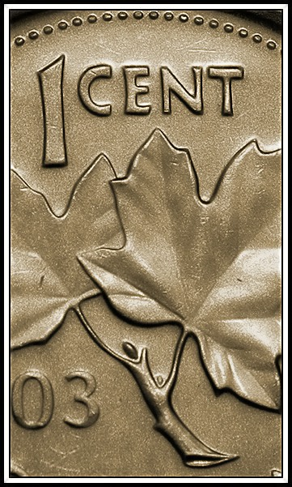
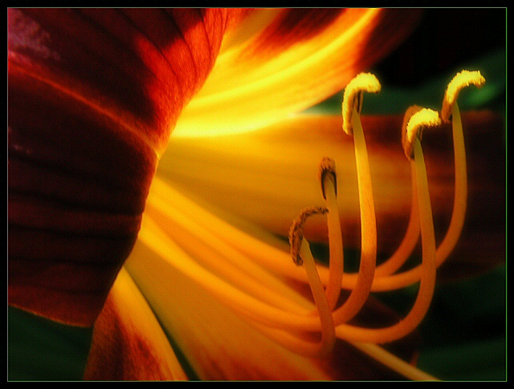
2. Use space wisely and Fill the Frame.
Completely fill the frame with positive space.
Notes:
The key is simplicity
Be sure that only the things you want the viewer to see appear in the picture. If there are numerous objects cluttering up the background, your message will be lost.
If you can’t find an angle or framing to isolate your subject, consider using depth of field control to keep the background out of focus.
Whatever it is, the secondary elements within the scene should support and not pull attention away from it.
Multiple centers of interest may work in three-ring circuses where viewers are able to fully shift their interest from one event to another. But competing centers of interest within a single visual frame weaken, divide and confuse meaning.

Slide 15

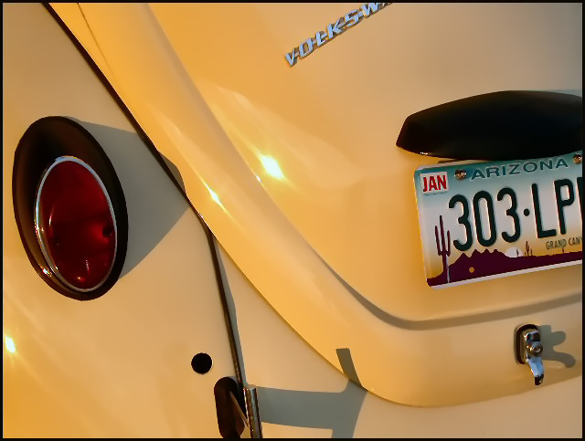
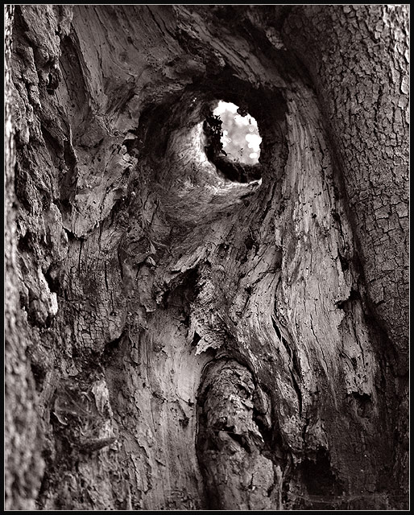
2. Use space wisely and Fill the Frame.
Empty space can be effective if used right, but don’t lose details by being to far away – Fill the Frame!
Notes:
The key is simplicity
Be sure that only the things you want the viewer to see appear in the picture. If there are numerous objects cluttering up the background, your message will be lost.
If you can’t find an angle or framing to isolate your subject, consider using depth of field control to keep the background out of focus.
Whatever it is, the secondary elements within the scene should support and not pull attention away from it.
Multiple centers of interest may work in three-ring circuses where viewers are able to fully shift their interest from one event to another. But competing centers of interest within a single visual frame weaken, divide and confuse meaning.

Slide 16



2. Use space wisely and Fill the Frame.
Filling the frame
Not filling the frame
Use your LEGS
Use your Optical Zoom
Crop your shots (last option)
Notes:
The key is simplicity
Be sure that only the things you want the viewer to see appear in the picture. If there are numerous objects cluttering up the background, your message will be lost.
If you can’t find an angle or framing to isolate your subject, consider using depth of field control to keep the background out of focus.
Whatever it is, the secondary elements within the scene should support and not pull attention away from it.
Multiple centers of interest may work in three-ring circuses where viewers are able to fully shift their interest from one event to another. But competing centers of interest within a single visual frame weaken, divide and confuse meaning.

Slide 17
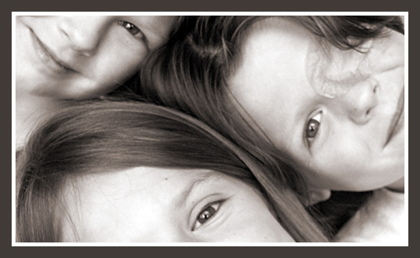

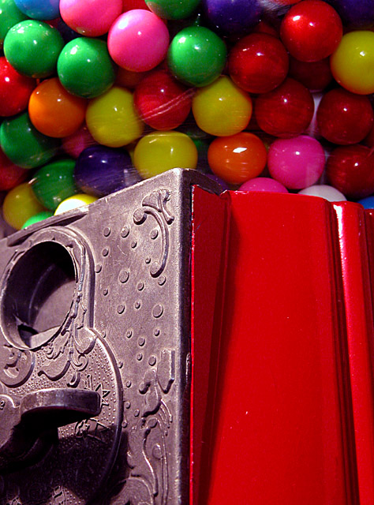
2. Use space wisely and Fill the Frame.
As soon as you think you are
close enough – GET CLOSER!!!
Notes:
The key is simplicity
Be sure that only the things you want the viewer to see appear in the picture. If there are numerous objects cluttering up the background, your message will be lost.
If you can’t find an angle or framing to isolate your subject, consider using depth of field control to keep the background out of focus.
Whatever it is, the secondary elements within the scene should support and not pull attention away from it.
Multiple centers of interest may work in three-ring circuses where viewers are able to fully shift their interest from one event to another. But competing centers of interest within a single visual frame weaken, divide and confuse meaning.

Slide 18

Ok, now that you have a subject of interest, where do you place that subject within your frame?

Slide 19
When we look at an image, our eyes tend to naturally go to these four areas of the frame.

Slide 20
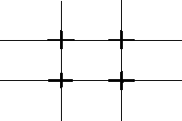
By breaking our frame into thirds, horizontally and vertically, we create a grid with intersecting points where your eyes naturally tend to look.

Slide 21
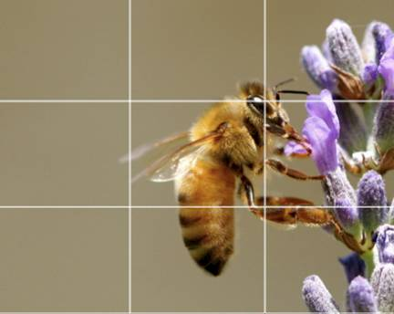
3. Compose your image using the Rule of Thirds.
Get your subject away from the center of your frame.
Try placing important elements at an intersecting point on the grid.

Slide 22
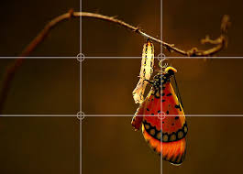

Slide 23
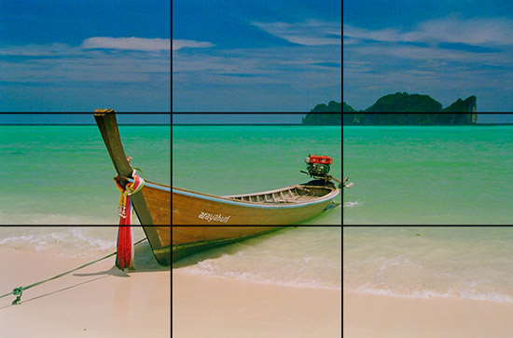

Slide 24
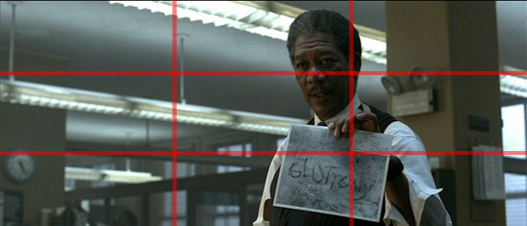
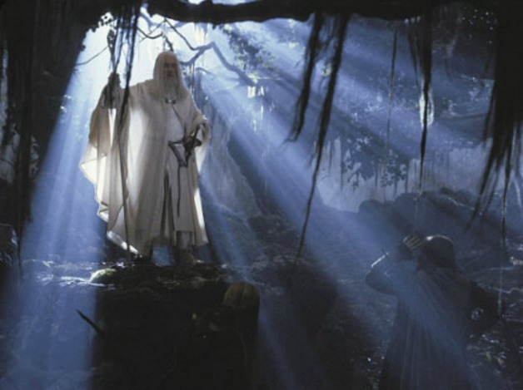
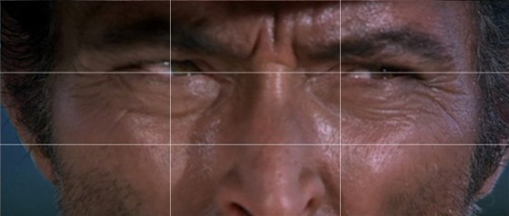
Even in the movies…

Slide 25
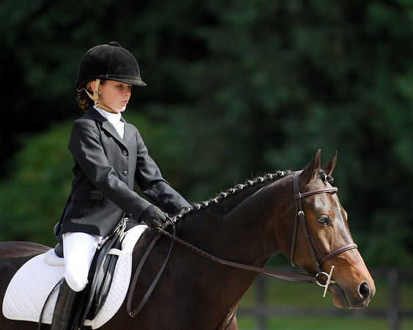

Slide 26


Slide 27


Slide 28

Avoid putting horizontal or vertical elements directly in the middle of the frame.

Slide 30

Avoid putting horizontal or vertical elements directly in the middle of the frame.

Slide 32

If the sky is your main focus, move the horizon down low to the bottom 1/3

Slide 33

If the water or ground is your main focus, move the horizon up high to the top 1/3.

Slide 34


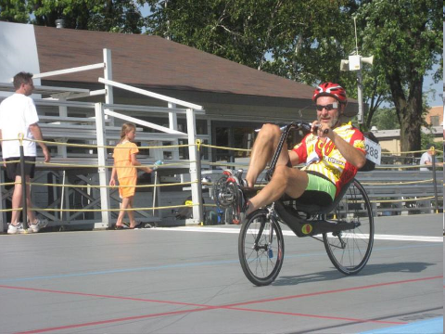
4. Lead your subject.
Give your subject some space to move into…

Slide 35
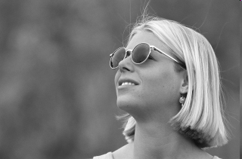


4. Lead your subject.
… and somewhere to look.

Slide 36


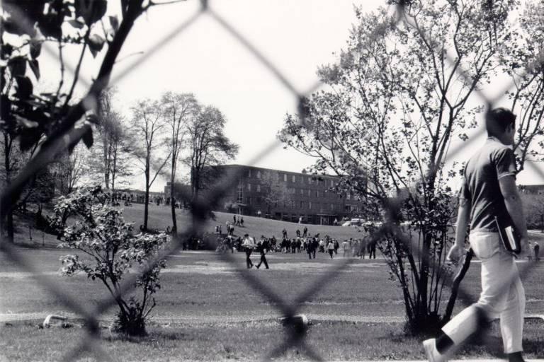
There’s something unsettling about a photograph of a moving subject that is too close to the edge of the frame.
It feels as if the subject is going to walk right out of the image.

Slide 37
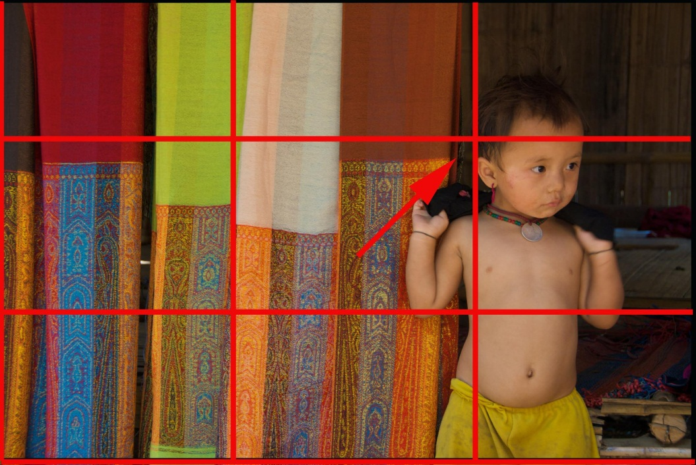


The same thing happens if someone is staring at something outside of the frame.

Slide 38
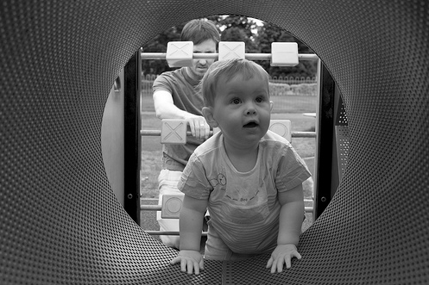
  5. Frame your subject.
In order to draw attention to your subject, try creating a frame around the subject within your image.

Slide 39


  5. Frame your subject.

Slide 40

6. Leading Lines are a design element that help direct your viewer through the image.

Slide 41
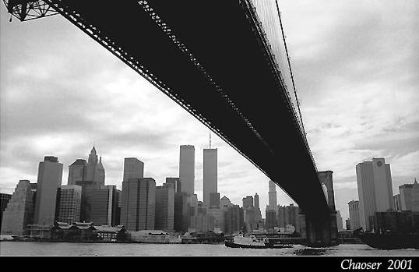
  6. Use Lines in your composition.

Slide 42

  6. Use Lines in your composition.
Lines –guide the viewer through your image.

Slide 43

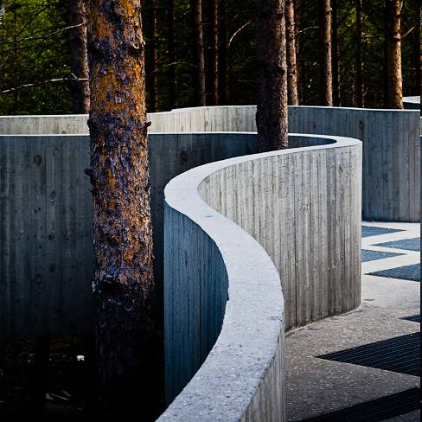
  Use Lines in your composition.
Lines –guide the viewer through your image.

Slide 44
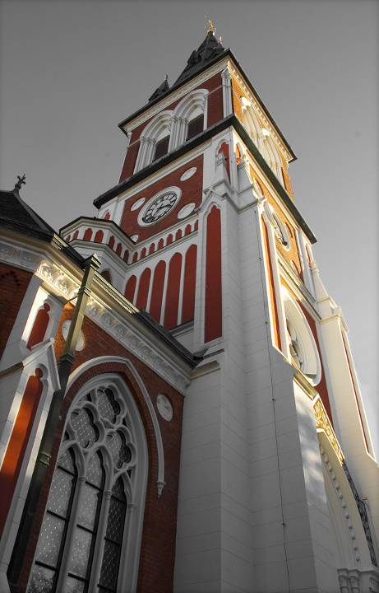
7. Change your Visual Perspective
The world doesn’t exist just at eyelevel.
Use unique angles to capture images from different perspectives.

Slide 45
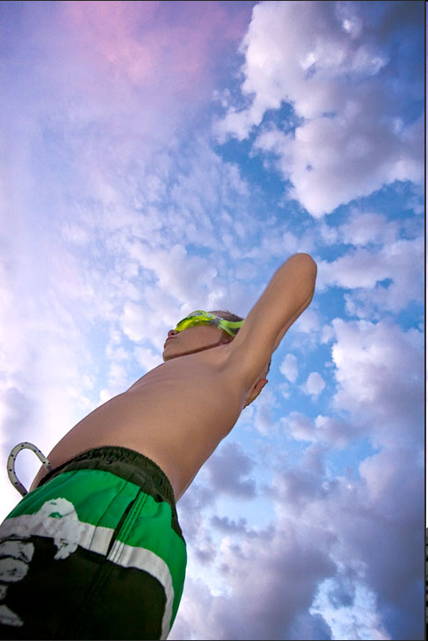

7. Visual Perspective

Slide 46
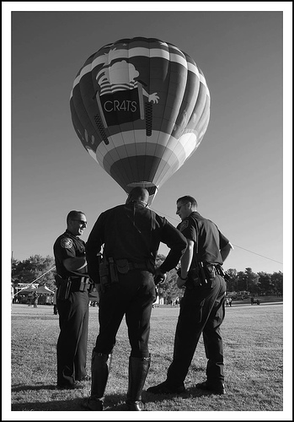
8. Mergers
Mergers are created when two elements in your image overlap and blend together.
They can be broken down into three categories:

Slide 47
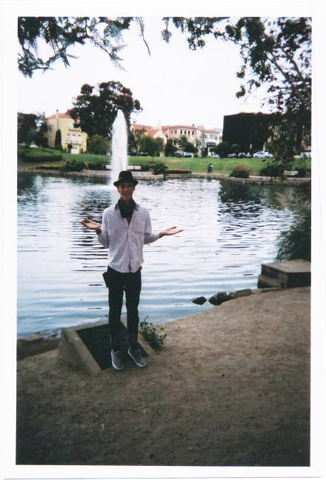


8. Be careful of Mergers
Dimensional Mergers: When physical elements in your image overlap.

Slide 48


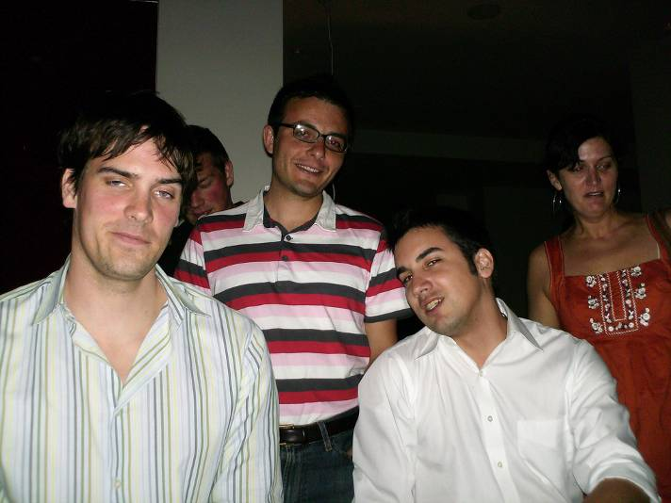
8. Mergers
Tonal Mergers: When the colors in your subjects blend into the background.
merged
Not merged

Slide 49
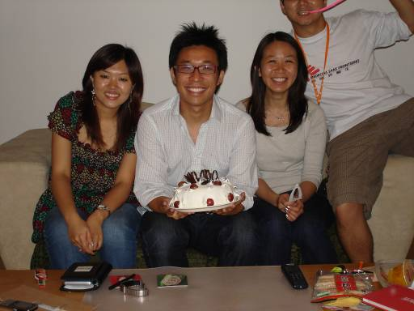

8. Mergers
Border Mergers: Objects are cut off by the edges of the frame.

Slide 50
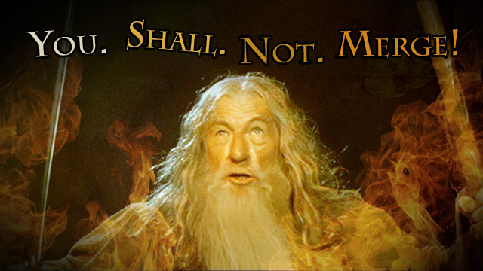
…Unless it is done well, and on purpose…

Slide 51
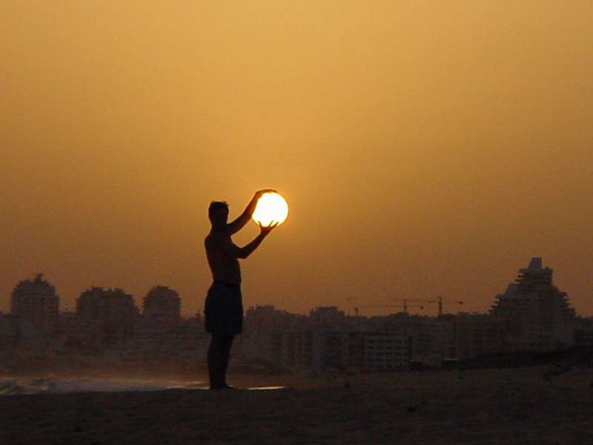


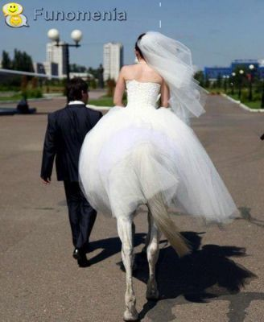

Planned Mergers

Slide 52

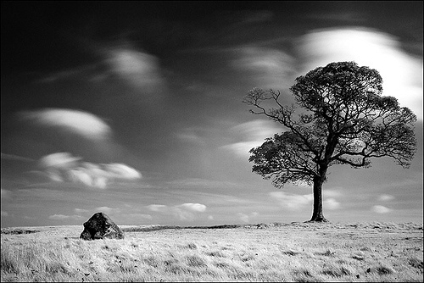
The best way to learn photography is to look at other photographs and think about what makes that image pleasing to look at.
You should be able to identify some of the elements of good composition in every image you find interesting or enjoyable.

Slide 53


Slide 54


Slide 55


Slide 56


Slide 57


Slide 58
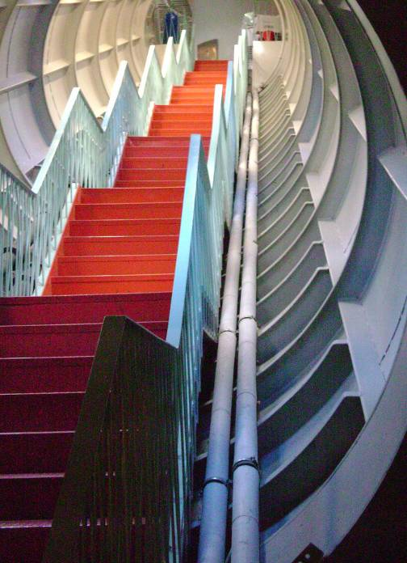

Slide 59


Slide 60
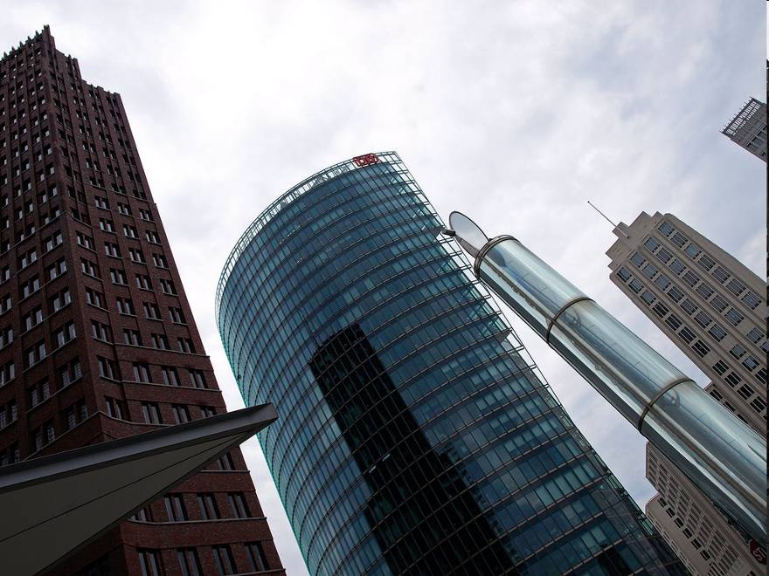

Slide 61


Slide 62
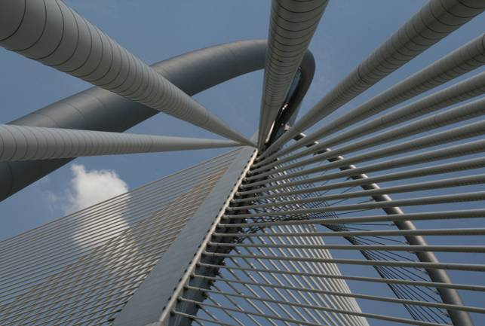

Slide 63


Slide 64


Slide 65
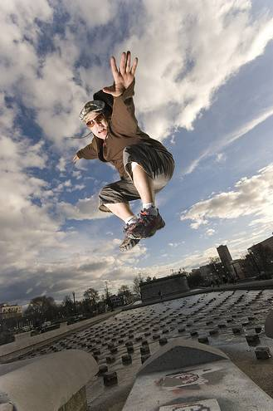

Slide 66


